Slide 1
Data Bootcamp - Final Project
Shawn Yoon & Devansh Dalmia

Slide 2
Project Overview
In the quest for recovery, market leading companies from all industries are competing against each other to increase their market presence while continuing to face challenges like slim operating margins, high capital expenditure, shortening product lifecycle and managing a global supply chain. Market capitalization and revenue are two of the simplest types of value estimation, but they're often frequently misunderstood.
The project measures the market capitalization of industry leading companies over (1980 - 2019) in the United States. The project aims to analyze the most valuable companies and the dominance of the tech sector in the recent years. The top performer being Amazon that has become one of the most valuable firm in the world. A lot of research has been made about the performance and returns of different sectors. During 2014 the stock market was booming but the growth was halted in 2015. From the sectors, energy companies have had the worst year, generating negative return of 13.7%.
The project use graphs to compare the market value of the top performers for each sector and find correlation between the market performance of the companies and their revenues respectively. The market cap can be seen as a public opinion of what is the monetary value of a public corporation.

Slide 3
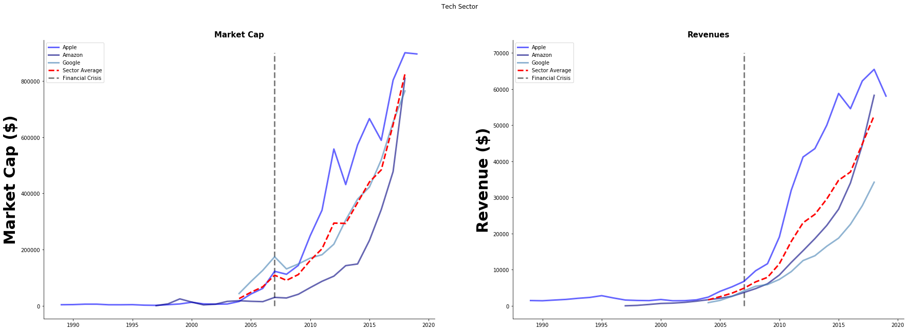
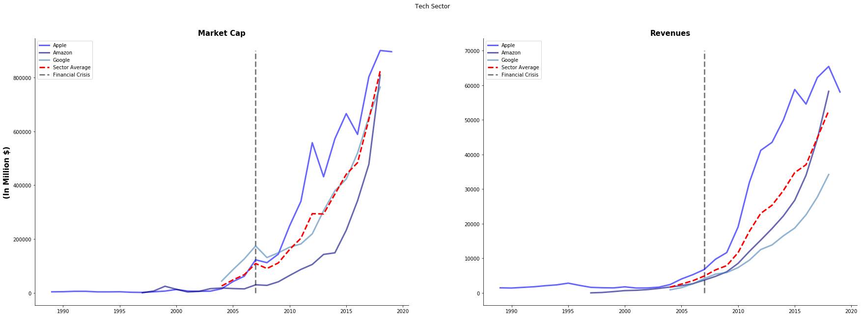
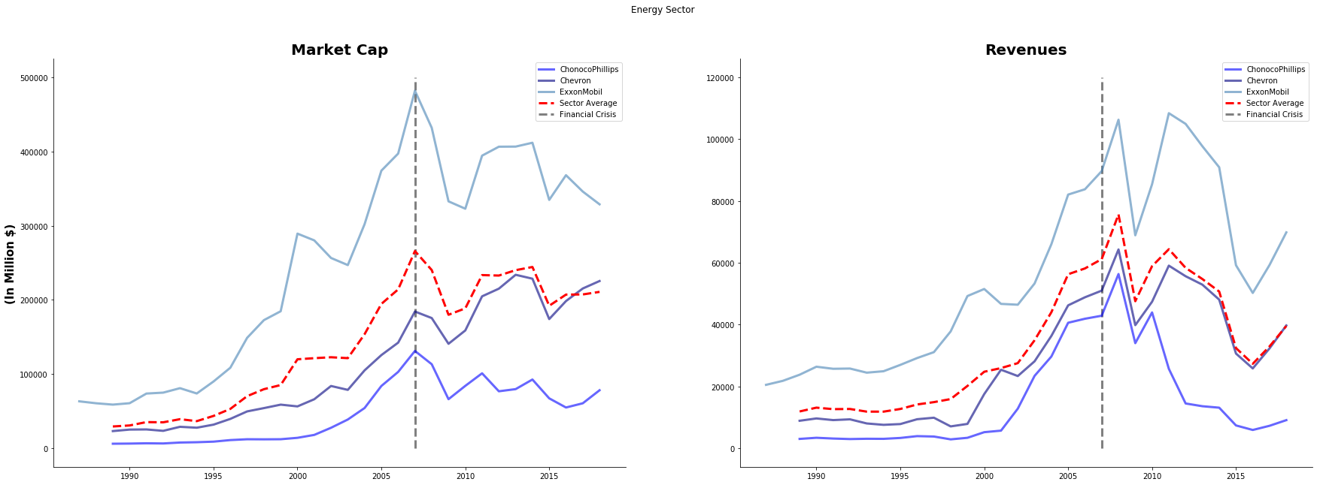
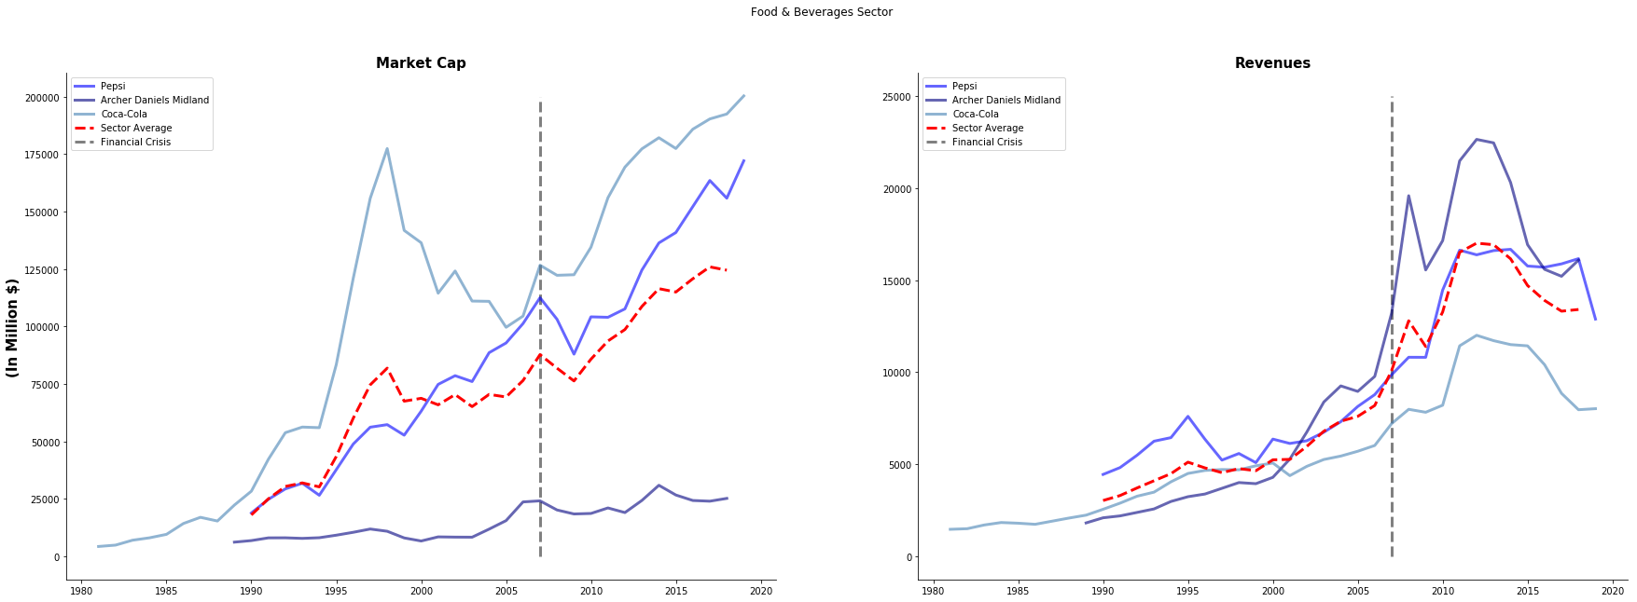
Technology
Energy
Consumer
The tech industry faced a sharp increase in revenue generation and market cap following the financial crisis. the industry is poised to grow in the future fueled by factors like price erosion, higher per capita income and consumer attachments to phones and other mobile devices.
The energy industry faced a downfall in market capitalization after the financial crisis of 2008. There has been a significant transition in the energy usage prompted by government regulation and ambitions to promote prosperity while addressing risks of climate change.
The consumer goods industry has shown steady performance in revenue and market cap even during and after the financial crisis. Industry leaders like Coca-Cola have maintained their lead even after trend shifts to healthier alternatives by acquiring new companies and re positioning their brand.

Slide 4
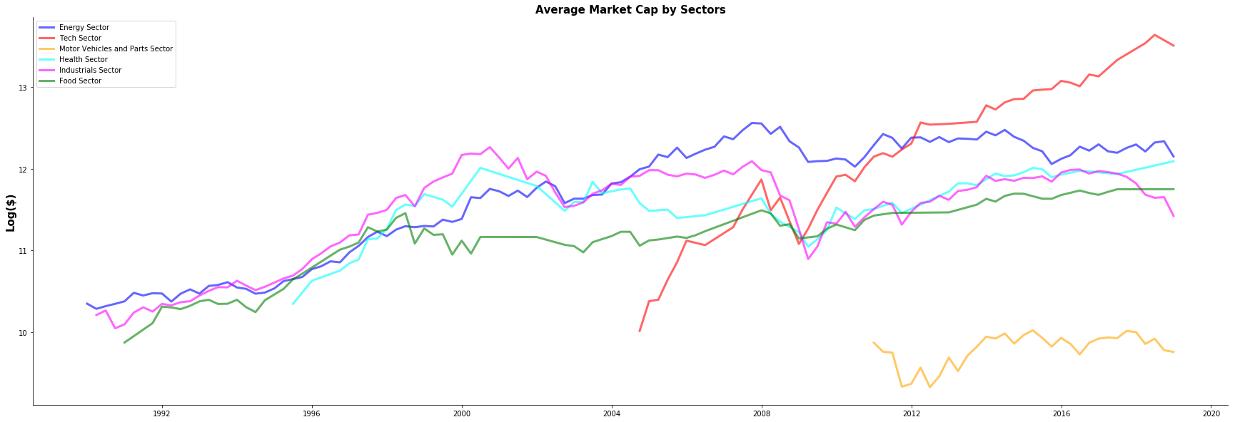
Measuring the Average Market Cap by Industry (log)
By using the log scale, we are able to clarify and visually represent the speed in the emergence of the tech sector capturing market share from other industries. We can also note the stagnant nature of consumer goods industry and the health industry. An important note would be the emergency of energy companies to dominate and substantially lose their position in the market place as well as the technology sector indicating signs of overvaluation following 2018.

Slide 5
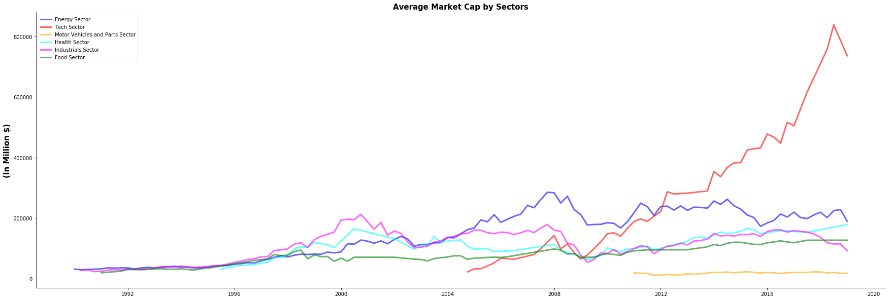
Measuring the Average Market Cap by Industry

Slide 6
Conclusion
The changing landscape of the US markets, due to technology innovations and future regulations has had a large impact on the market structure and the market cap of several industries. Each of the company in the study has gone through waves of mergers and acquisitions to reposition itself in the changing landscape and maintain its dominant position. This is evident by one of the strongest indicator of a company’s value in the marketplace.
The market outlook for Exxonmobil for instance, has failed to account for public sentiment about climate concerns and is facing increased competition to maintain its dominant position in the energy industry. Contrastingly, a company like Coca-Cola has successfully been able to maintain its lead due to the brand evolving with age.
The data reports show hints of correlation between company market share and the revenue it generates. This can be concluded by the effect of the financial crisis leading to declining revenues

